Slide 1

MC Health Care Consulting LLC
Sacred Vocation

Slide 2

INTRO
Meaning in the work of healing

Slide 3

;
Contents
Introduction
History of SV
Core Principles
My Story
Why Now
Pandemic Impact
Course Purpose & Benefits
Course Structure
Org Alignment
Outcomes Impact
Testimonials
Next Steps

Slide 4

History
The Sacred Vocation Program is offered with permission of the McGovern Center for Humanities and Ethics at UTHealth Houston.
The original Sacred Vocation Program was conceptualized and developed by Rabbi Samuel Karff, Drs. Benjamin C. Amick III and Jessica Tullar for health care workers.
It has been revised for a professional audience by Sylvia Villarreal, Rebecca Lunstroth, and Drs. Thomas Cole and Kelli Cohen Fein.
Grew to become both a retention and employee satisfaction strategy that proved to be effective in several hospitals throughout the country
.

Slide 5

Many people choose to go into healthcare to help others but lose sight of that sense of calling over time due to stressful situations
Every encounter is an opportunity: to be a healer or a harmer
Re-engaging focus on healing interactions leads to a sense of meaning in our work
Core Principles

Slide 6
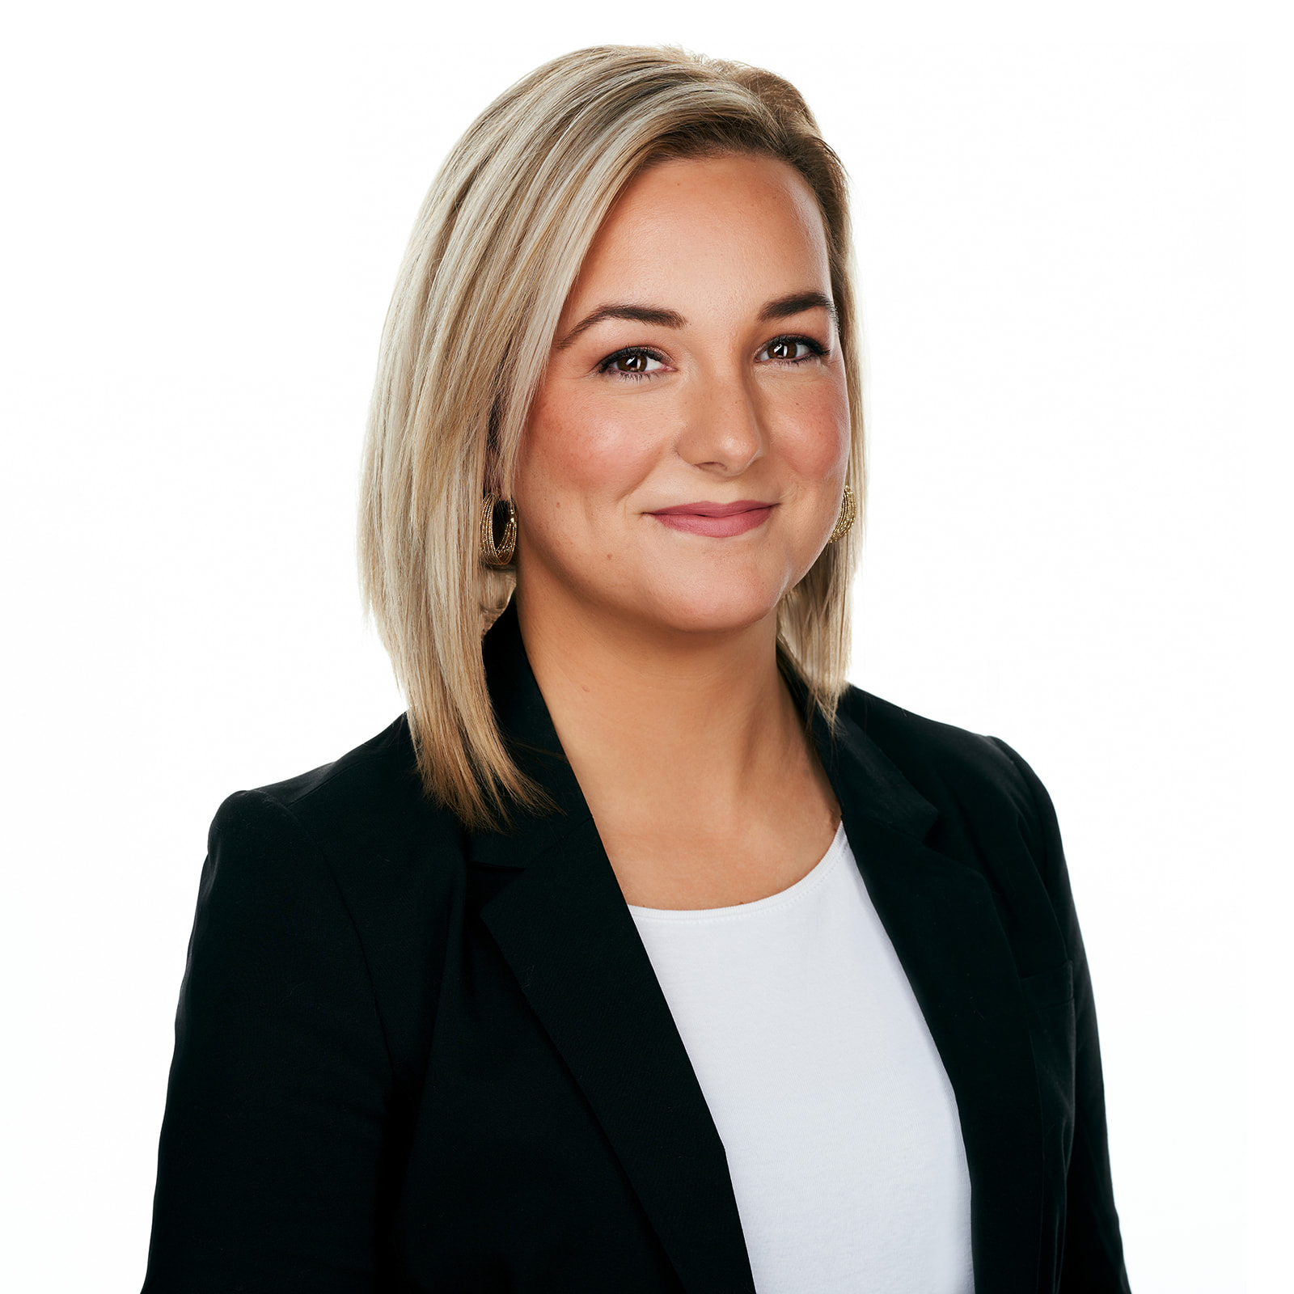
I experienced Sacred Vocation for the first time as a new nurse manager at Baylor Grapevine. It was so powerful that I asked to participate in it a second time. When I moved to my Director role in Kentucky, I brought the SV trainers to our hospital to train several of us. We rolled out SV across the system. I also brought it with me to THR as an ACNO. It’s an incredibly effective forum to re-center healthcare workers and leaders on being healers thereby regaining their sense of meaning in their work.
Megan Carter
FACILITATOR

Slide 7


Impact of the Pandemic:
Released May 23.2022
“Today when I visit hospitals, clinics or health departments and ask staff how they are doing, many tell me they feel exhausted, helpless and heartbroken…they confess they don’t see how the healthcare workforce can continue like this. Something needs to change.”
-New Surgeon General Advisory Sounds Alarm on Healthcare Worker Burnout and Resignation | HHS.gov

Slide 8

Compassion Fatigue
COVID may recede, but the ripple effect of the pandemic on our mental, physical and spiritual well-being will be felt for years to come
Many of us have lost our sense of meaning in our work or even our trust in humanity
Healthcare worker burnout and turnover is at an all time high globally
We need to reconnect with our why…or we will lose more precious talent which will limit our capacity to meet the needs of the communities we serve

Slide 9
WHAT IS SACRED VOCATION?
IS
IS NOT
A powerful tool to combat compassion fatigue and healthcare worker (HCW) burnout
A psychologically safe place for HCWs to engage in structured dialogue focused on their own power to be a healing presence in every interaction
Evidence based approach to support us in doing our life’s best work
For all employees and leaders!
A “kumbaya” session
An action plan for low performing employees
Mandatory education or training
EAP/counseling
Specific to direct caregivers

Slide 10



Benefits of SV
;
“…if we want employees to care for patients and be supportive of patients’ families, we must care for the employee first and link their work to what gives meaning to them in their own lives. Meaningful work is a non-monetary reward that may make the difference between your employees enjoying their jobs or looking for someplace else to work.” The Sacred Vocation Program Guide

Slide 11

Course Structure
5 Classes (led by trained facilitator)
  Session 1: Discovering Meaning
  Session 2: Capacity to Heal
  Session 3: Capacity to Harm
  Session 4: Developing Coping Tips
  Session 5: Oath for Healing
Time Commitment
  1-1.5 hrs per class
  10-12 participants per cohort
  Total of 8 hours classroom per employee over 5 weeks
Graduation/Oath Ceremony
  1-2 hrs
  Leadership Team attends and graduates recite their group’s sacred vocation oath for healing
  Share reflections on program and any benefits it provided

Slide 12
Org Alignment
Diversity, Equity & Inclusion
Retention Strategy
Magnet/Accreditation Standards
SV facilitates better understanding of our own beliefs, values and bias that influence our interactions as healers or harmers
  Organizations who help employees connect meaning in their work have a strategic advantage over competitors, even if pay is equal
  Moving from paycheck to purpose
  Gen Z/Millennials rated “Leaders who care about my well being” as a top factor in choosing a workplace
SV supports a Magnet culture of collaboration, patient safety and nurse empowerment

Slide 13



OUTCOMES IMPACT
Reduced employee turnover
Increased employee satisfaction/engagement
  Recent survey results around well-being
Work and Meaning Inventory
Increased PFX scores
  Communication with Nurses/Doctors
  Team worked together to care for me
  Care explained in a way that you understand

Slide 14


Leadership Cohort
“I didn’t realize how much I needed this…thank you Megan for bringing this to us and thank you to Administration for supporting us…I finally feel like I can look forward to coming to work every day…”
Testimonial
Frontline Cohort
“The facilitators did a great job of making me feel comfortable sharing stories…and reflecting on the moments when I was a harmer instead of a healer…I feel refreshed and ready to be a healer to everyone again…”

Slide 15
NEXT STEPS

Slide 16
Megan Carter DNP, RN, NEA-BC
Megan.carter.msn@gmail.com
www.mchealthcareconsultingllc.com
THANK YOU

